Slide 1
Chapter 2 Data Models
2.1 Introduction
2.2 Conceptual, Logical and Physical Model
2.3 E-R Model
2.4 Relation with UML Class Diagram
2.5 Alternate Data Model(Network data model, Hierarchical data model)

Slide 2
2.1 Introduction
The basic structure or design of the database is the data model.
A data model is a collection of conceptual tools for describing data, data relationships, data semantics, and consistency constraints.
Data Models are fundamental entities to introduce abstraction in a DBMS.
Data models define how data is connected to each other and how they are processed and stored inside the system.

Slide 3
2.2 Conceptual, Logical and Physical Model
Conceptual Data Model:
A conceptual data model identifies the highest-level relationships between the different entities.
Features of conceptual data model include:
Includes the important entities and the relationships among them.
No attribute is specified.
No primary key is specified.
The figure below is an example of a conceptual data model

Slide 4
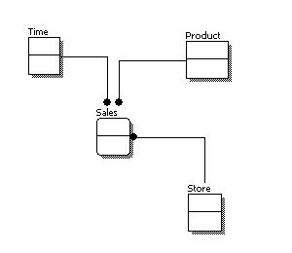
2.2 Conceptual, Logical and Physical Model
Conceptual Data Model:

Slide 5
2.2 Conceptual, Logical and Physical Model
Logical Data Model:
A logical data model describes the data in as much detail as possible, without regard to how they will be physical implemented in the database.
Features of a logical data model include:
Includes all entities and relationships among them.
All attributes for each entity are specified.
The primary key for each entity is specified.
Foreign keys (keys identifying the relationship between different entities) are specified.
Normalization occurs at this level.

Slide 6
2.2 Conceptual, Logical and Physical Model
contd.
Logical Data Model:
The steps for designing the logical data model are as follows:
Specify primary keys for all entities.
Find the relationships between different entities.
Find all attributes for each entity.
Resolve many-to-many relationships.
Normalization.

Slide 7
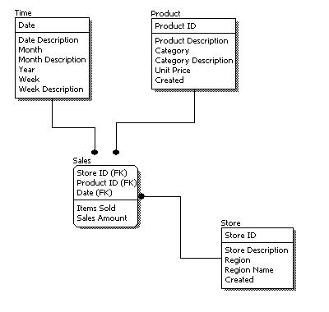
2.2 Conceptual, Logical and Physical Model
contd.
Logical Data Model:

Slide 8
2.2 Conceptual, Logical and Physical Model
contd.
Logical Data Model:
Comparing the logical data model shown above with the conceptual data model diagram, we see the main differences between the two:
In a logical data model, primary keys are present, whereas in a conceptual data model, no primary key is present.
In a logical data model, all attributes are specified within an entity. No attributes are specified in a conceptual data model.
Relationships between entities are specified using primary keys and foreign keys in a logical data model.
In a conceptual data model, the relationships are simply stated, not specified, so we simply know that two entities are related, but we do not specify what attributes are used for this relationship.

Slide 9
2.2 Conceptual, Logical and Physical Model
Physical Data Model:
Physical data model represents how the model will be built in the database. A physical database model shows all table structures, including column name, column data type, column constraints, primary key, foreign key, and relationships between tables.
Features of a physical data model include:
Specification all tables and columns.
Foreign keys are used to identify relationships between tables.
Denormalization may occur based on user requirements.
Physical considerations may cause the physical data model to be quite different from the logical data model.
Physical data model will be different for different RDBMS. For example, data type for a column may be different between Oracle, DB2 etc.

Slide 10
2.2 Conceptual, Logical and Physical Model
contd.
Physical Data Model:
The steps for physical data model design are as follows:
Convert entities into tables.
Convert relationships into foreign keys.
Convert attributes into columns.
Modify the physical data model based on physical constraints / requirements.

Slide 11
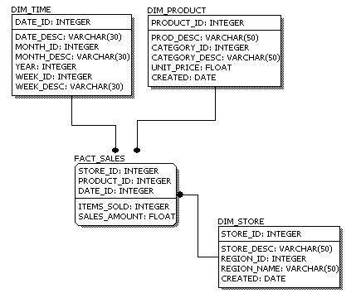
2.2 Conceptual, Logical and Physical Model
contd.
Physical Data Model:

Slide 12
2.2 Conceptual, Logical and Physical Model
contd.
Physical Data Model:
Comparing the physical data model shown above with the logical data model diagram, we see the main differences between the two:
Entity names are now table names.
Attributes are now column names.
Data type for each column is specified. Data types can be different depending on the actual database being used.

Slide 13
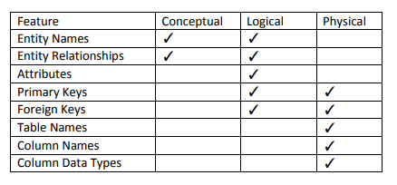
2.2 Conceptual, Logical and Physical Model
The table below compares the different features:

Slide 14
2.2 Conceptual, Logical and Physical Model
contd.
We can see that the complexity increases from conceptual to logical to physical.
This is why we always first start with the conceptual data model (so we understand at high level what are the different entities in our data and how they relate to one another).
Then move on to the logical data model (so we understand the details of our data without worrying about how they will actually implemented).
And, finally the physical data model (so we know exactly how to implement our data model in the database of choice).

Slide 15
2.3 E-R Model
An Entity–relationship model (ER model) describes the structure of a database with the help of a diagram, which is known as Entity Relationship Diagram (ER Diagram).
An ER model is a design or blueprint of a database that can later be implemented as a database. The main components of E-R model are: entity set and relationship set.
An ER diagram shows the relationship among entity sets.
An entity set is a group of similar entities and these entities can have attributes.

Slide 16
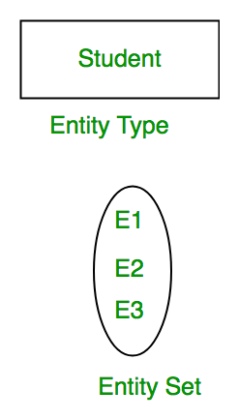
2.3 E-R Model
1. Entity, Entity Type, Entity Set :
An Entity may be an object with a physical existence - a particular person, car, house, or employee – or it may be an object with a conceptual existence – a company, a job, or a university course.
An Entity is an object of Entity Type and set of all entities is called as entity set.
Example, E1 is an entity having Entity Type Student and set of all students is called Entity Set.
In E-R diagram, Entity is represented by a rectangle.

Slide 17
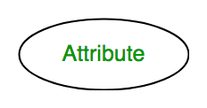
2.3 E-R Model
2. Attribute(s):
Attributes are the properties which define the entity type.
For example, Roll_No, Name, DOB, Age, Address, Mobile_No are the attributes which defines entity type Student.
In ER diagram, attribute is represented by an oval.

Slide 18
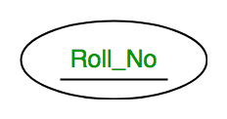
2.3 E-R Model
Types of Attribute:
a. Key Attribute –
The attribute which uniquely identifies each entity in the entity set is called key attribute.
For example, Roll_No will be unique for each student.
In ER diagram, key attribute is represented by an oval with underlying lines.

Slide 19
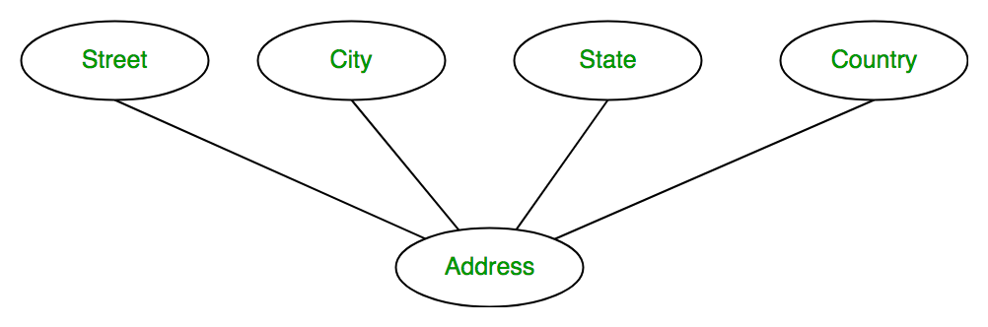
2.3 E-R Model
Types of Attribute:
b. Composite Attribute –
An attribute composed of many other attribute is called as composite attribute.
For example, Address attribute of student Entity type consists of Street, City, State, and Country.
In ER diagram, composite attribute is represented by an oval comprising of ovals.

Slide 20
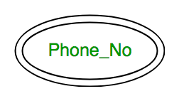
2.3 E-R Model
Types of Attribute:
c. Multivalued Attribute –
An attribute consisting more than one value for a given entity.
For example, Phone_No (can be more than one for a given student).
In ER diagram, multivalued attribute is represented by double oval.

Slide 21
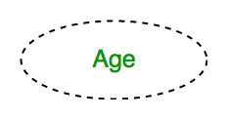
2.3 E-R Model
Types of Attribute:
d. Derived Attribute –
An attribute which can be derived from other attributes of the entity type is known as derived attribute.
Example, Age (can be derived from DOB).
In ER diagram, derived attribute is represented by dashed oval.

Slide 22
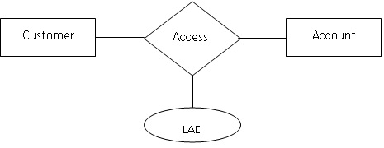
2.3 E-R Model
Types of attribute
e. Descriptive attribute
The attribute(s) used for describing the relationship is called descriptive attributes, also referred as relationship attributes.
They are actually used for storing information about the relationship.
A relationship can have zero or more attributes.
-LAD (Last Accessed Date)

Slide 23
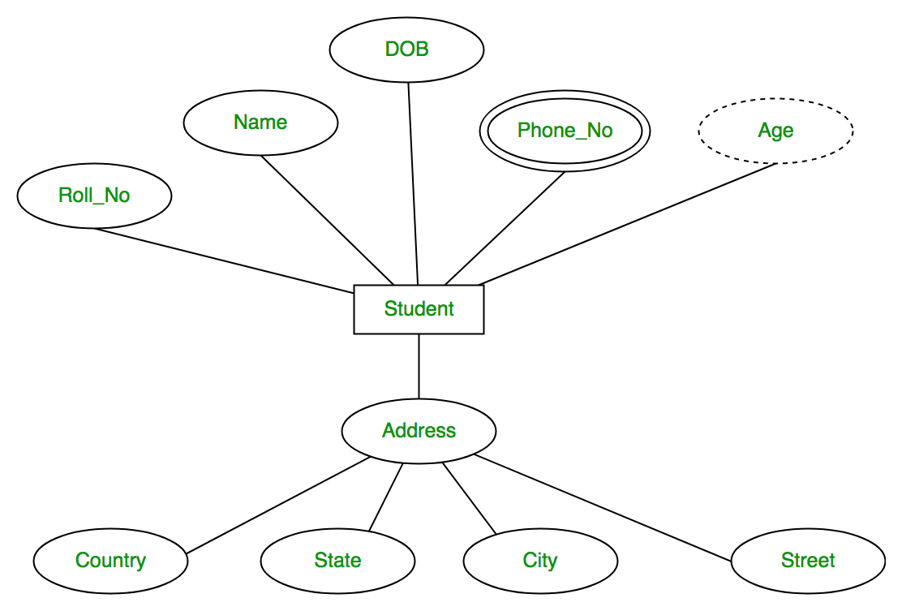
2.3 E-R Model
The complete entity type Student with its attributes can be represented as:

Slide 24
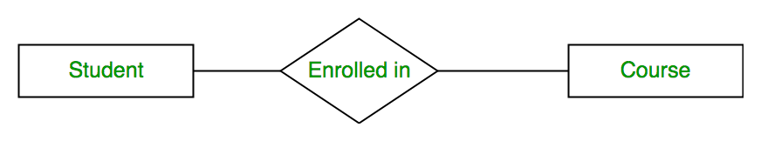
2.3 E-R Model
3. Relationship Type and Relationship Set:
A relationship type represents the association between entity types.
For example,‘Enrolled in’ is a relationship type that exists between entity type Student and Course.
In ER diagram, relationship type is represented by a diamond and connecting the entities with lines.

Slide 25
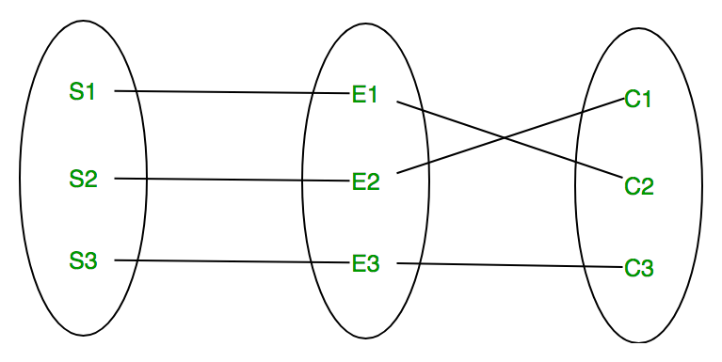
2.3 E-R Model
3. Relationship Type and Relationship Set:
A set of relationships of same type is known as relationship set.
The following relationship set depicts S1 is enrolled in C2, S2 is enrolled in C1 and S3 is enrolled in C3.

Slide 26
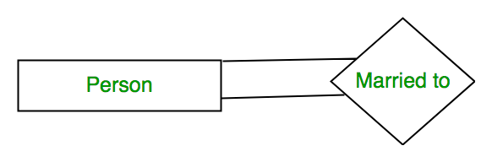
2.3 E-R Model
Degree of a relationship Set:
The number of different entity sets participating in a relationship set is called as degree of a relationship set.
1. Unary Relationship –
When there is only ONE entity set participating in a relation, the relationship is called as unary relationship.
For example, one person is married to only one person.

Slide 27
2.3 E-R Model
Degree of a relationship Set:
The number of different entity sets participating in a relationship set is called as degree of a relationship set.
2. Binary Relationship –
When there are TWO entities set participating in a relation, the relationship is called as binary relationship.
For example, Student is enrolled in Course.

Slide 28
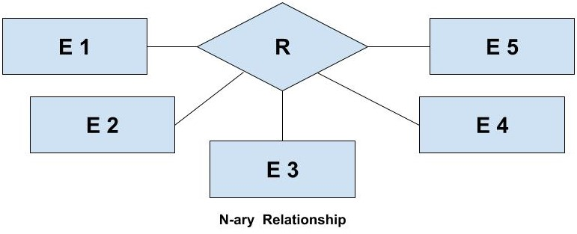
2.3 E-R Model
Degree of a relationship Set:
The number of different entity sets participating in a relationship set is called as degree of a relationship set.
2. n-ary Relationship –
When there are n entities set participating in a relation, the relationship is called as n-ary relationship.

Slide 29
2.3 E-R Model
Cardinality:
The number of times an entity of an entity set participates in a relationship set is known as cardinality.
Cardinality can be of different types:
One-to-one
Many-to-one
Many-to-many

Slide 30
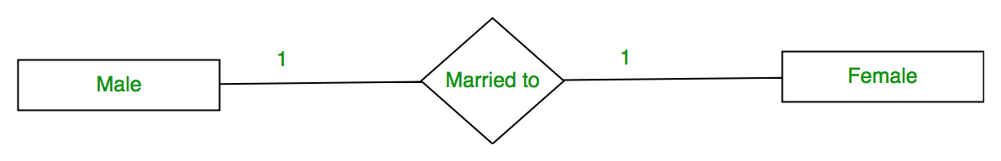
2.3 E-R Model
Cardinality:
1. One to one –
When each entity in each entity set can take part only once in the relationship, the cardinality is one to one.
Let us assume that a male can marry to one female and a female can marry to one male. So the relationship will be one to one.

Slide 31
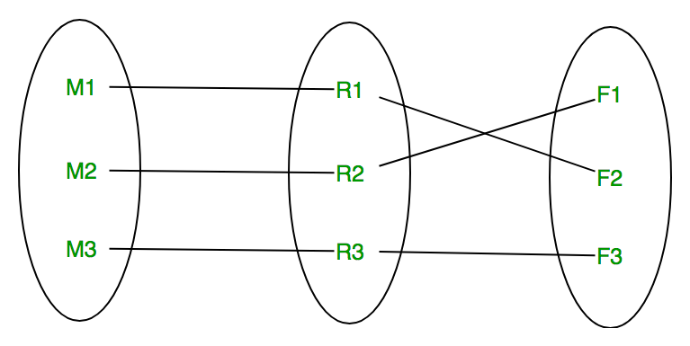
2.3 E-R Model
Cardinality:
1. One to one –
Using Sets, it can be represented as:

Slide 32
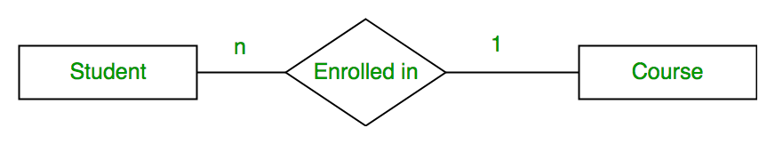
2.3 E-R Model
Cardinality:
2. Many to one –
When entities in one entity set can take part only once in the relationship set and entities in other entity set can take part more than once in the relationship set, cardinality is many to one.
Let us assume that a student can take only one course but one course can be taken by many students. So the cardinality will be n to 1.
It means that for one course there can be n students but for one student, there will be only one course.

Slide 33
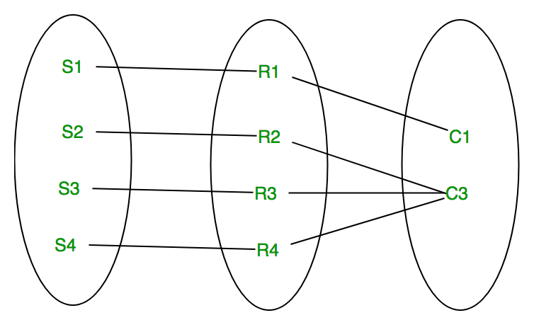
2.3 E-R Model
Cardinality:
2. Many to one –
Using Sets, it can be represented as:

Slide 34
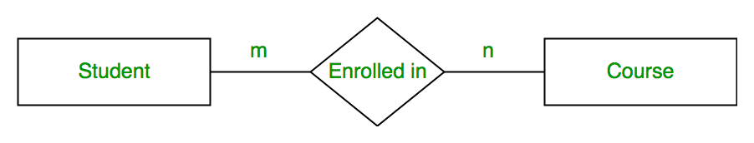
2.3 E-R Model
Cardinality:
3. Many to many –
When entities in all entity sets can take part more than once in the relationship cardinality is many to many.
Let us assume that a student can take more than one course and one course can be taken by many students. So the relationship will be many to many.

Slide 35
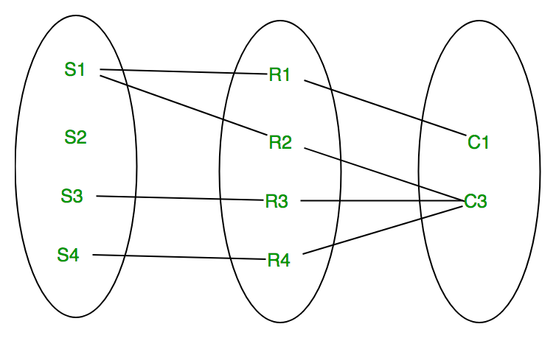
2.3 E-R Model
Cardinality:
3. Many to many –
Using Sets, it can be represented as:

Slide 36
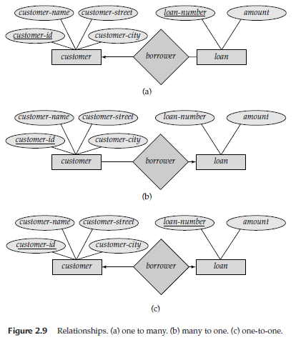
2.3 E-R Model
Cardinality:

Slide 37
2.3 E-R Model
Participation Constraint:
Participation Constraint is applied on the entity participating in the relationship set.
1. Total Participation –
Each entity in the entity set must participate in the relationship. If each student must enroll in a course, the participation of student will be total. Total participation is shown by double line in ER diagram.
2. Partial Participation –
The entity in the entity set may or may NOT participate in the relationship. If some courses are not enrolled by any of the student, the participation of course will be partial.

Slide 38
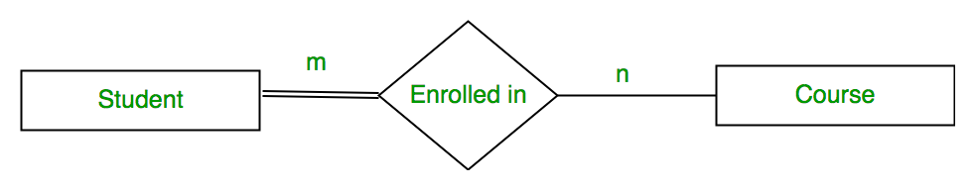
2.3 E-R Model
Participation Constraint:
The diagram depicts the ‘Enrolled in’ relationship set with Student Entity set having total participation and Course Entity set having partial participation.

Slide 39
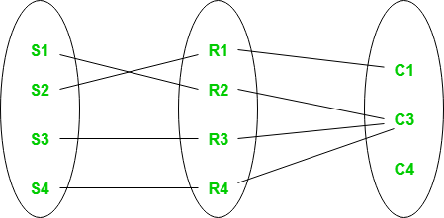
2.3 E-R Model
Participation Constraint:
Using set, it can be represented as
Every student in Student Entity set is participating in relationship but there exists a course C4 which is not taking part in the relationship.

Slide 40
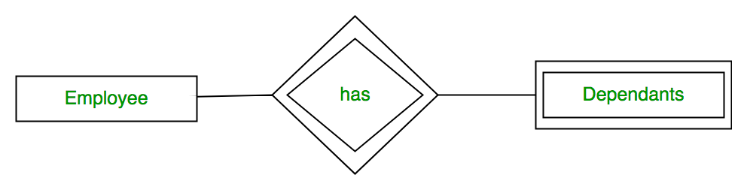
2.3 E-R Model
Weak Entity Type and Identifying Relationship:
An entity type has a key attribute which uniquely identifies each entity in the entity set.
But there exists some entity type for which key attribute can’t be defined. These are called Weak Entity type.
For example, A company may store the information of dependents (Parents, Children, Spouse) of an Employee.
But the dependents don’t have existence without the employee. So Dependent will be weak entity type and Employee will be Identifying Entity type for Dependent.
A weak entity type is represented by a double rectangle.
The participation of weak entity type is always total.
The relationship between weak entity type and its identifying strong entity type is called identifying relationship and it is represented by double diamond.

Slide 41
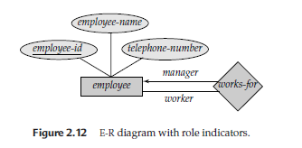
2.3 E-R Model
Role indicator:
If an entity set plays more than one role, role indicators describe the different purpose in the relationship.

Slide 42
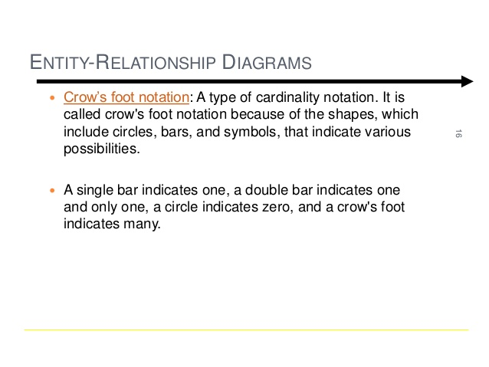
2.3 E-R Model

Slide 43
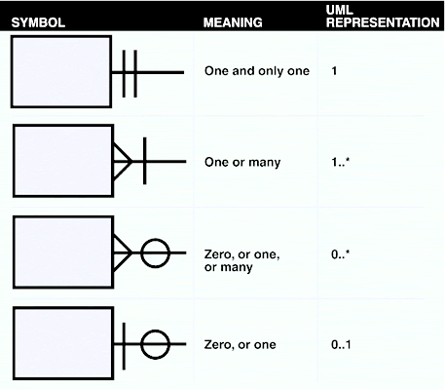
2.3 E-R Model

Slide 44
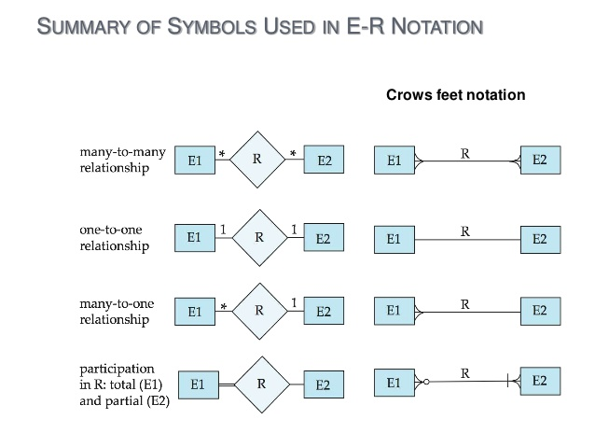
2.3 E-R Model

Slide 45
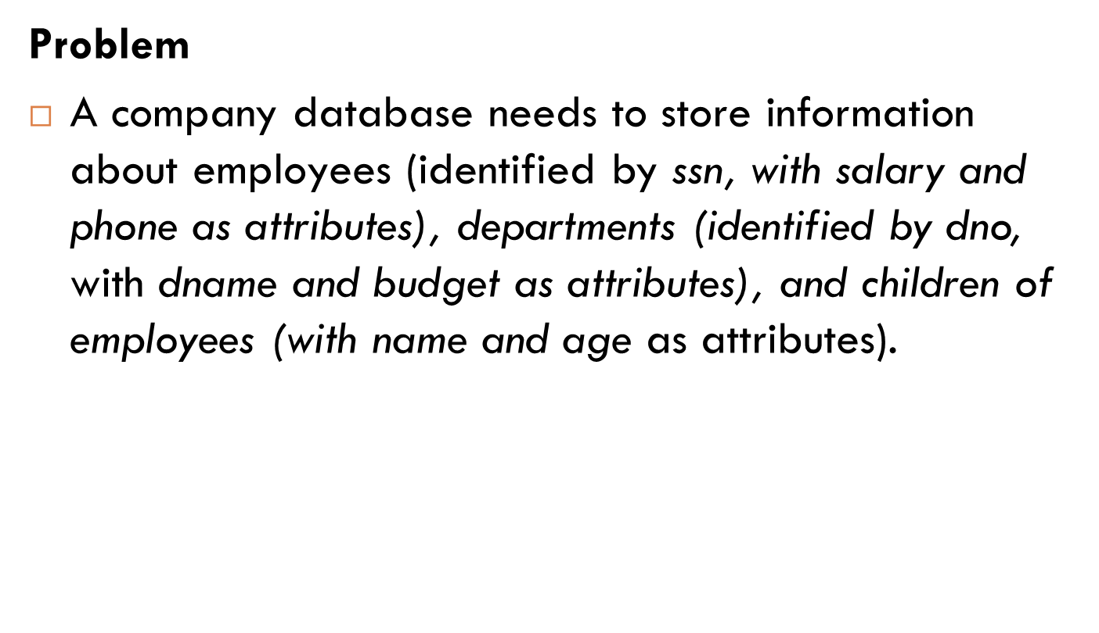
2.3 E-R Model

Slide 46
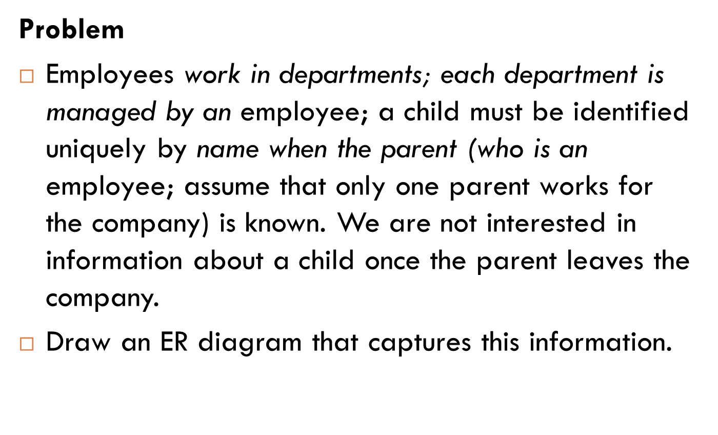
2.3 E-R Model

Slide 47
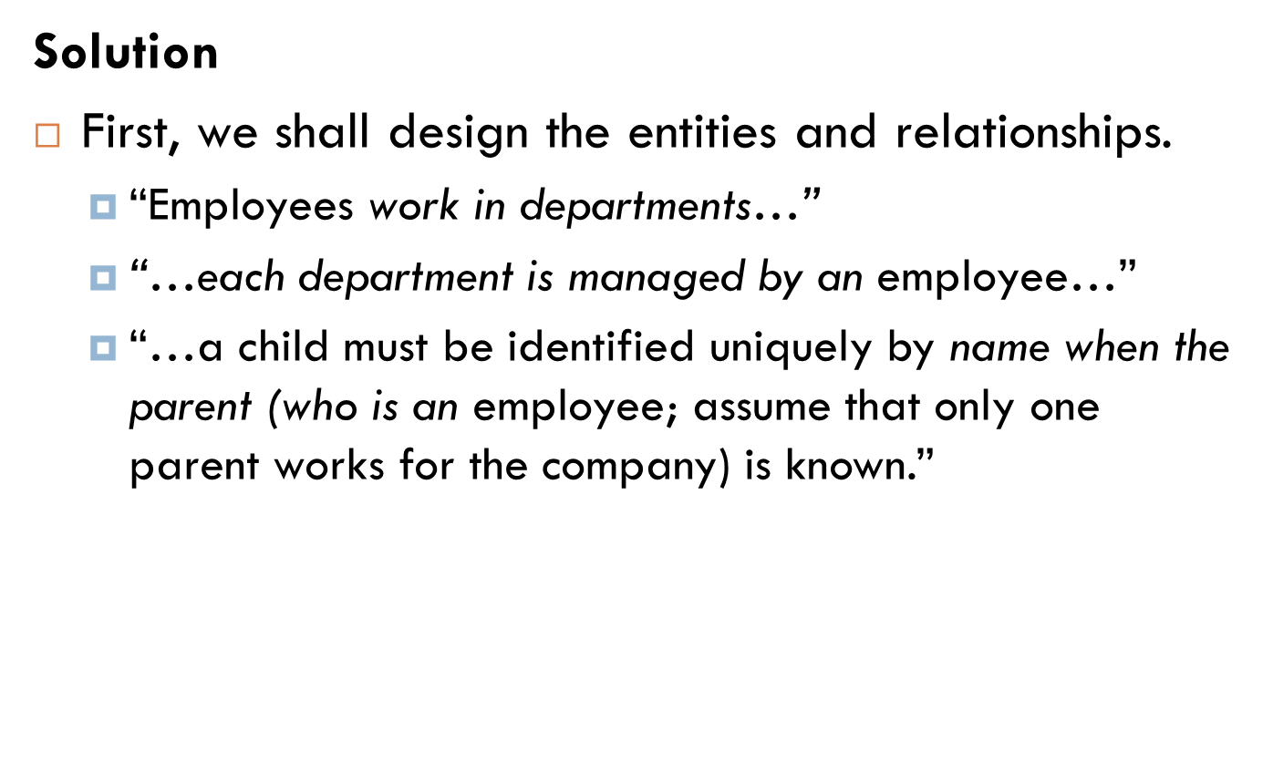
2.3 E-R Model

Slide 48
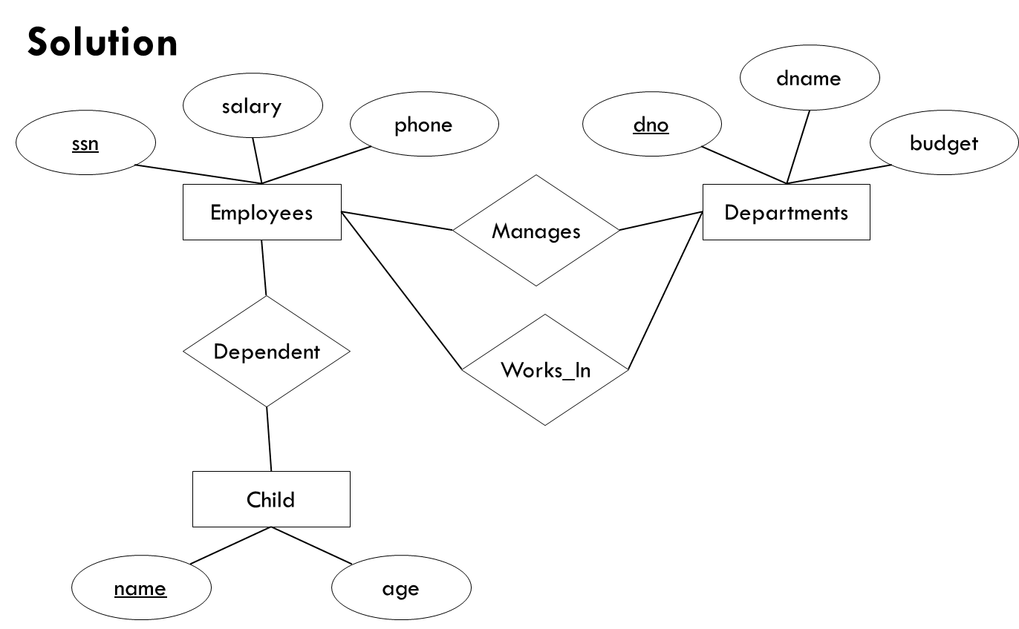
2.3 E-R Model

Slide 49
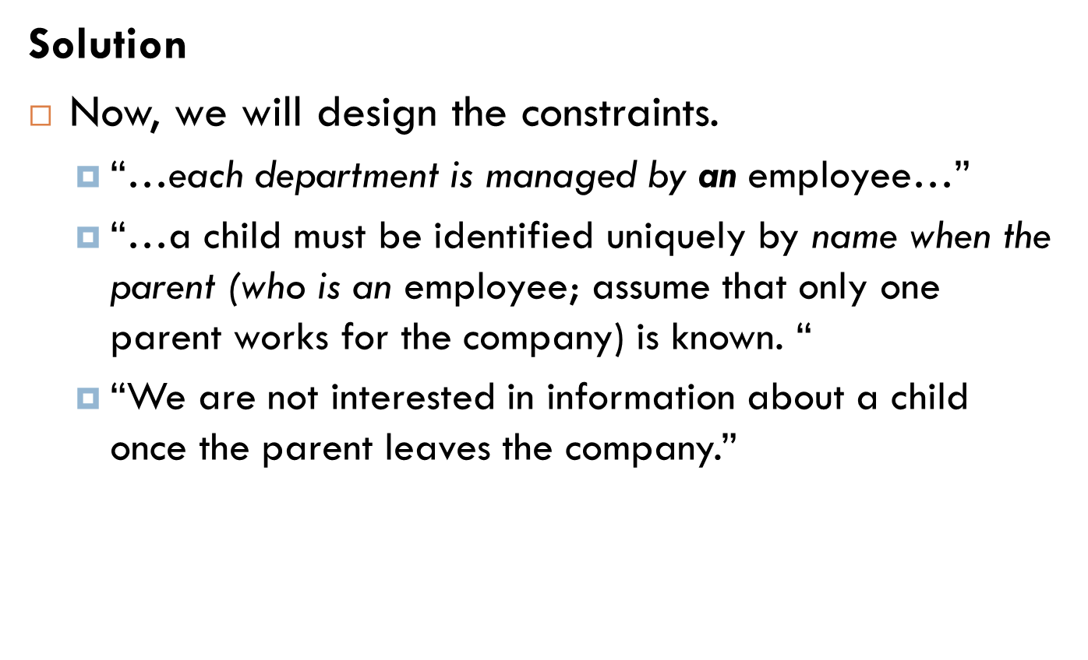
2.3 E-R Model

Slide 50
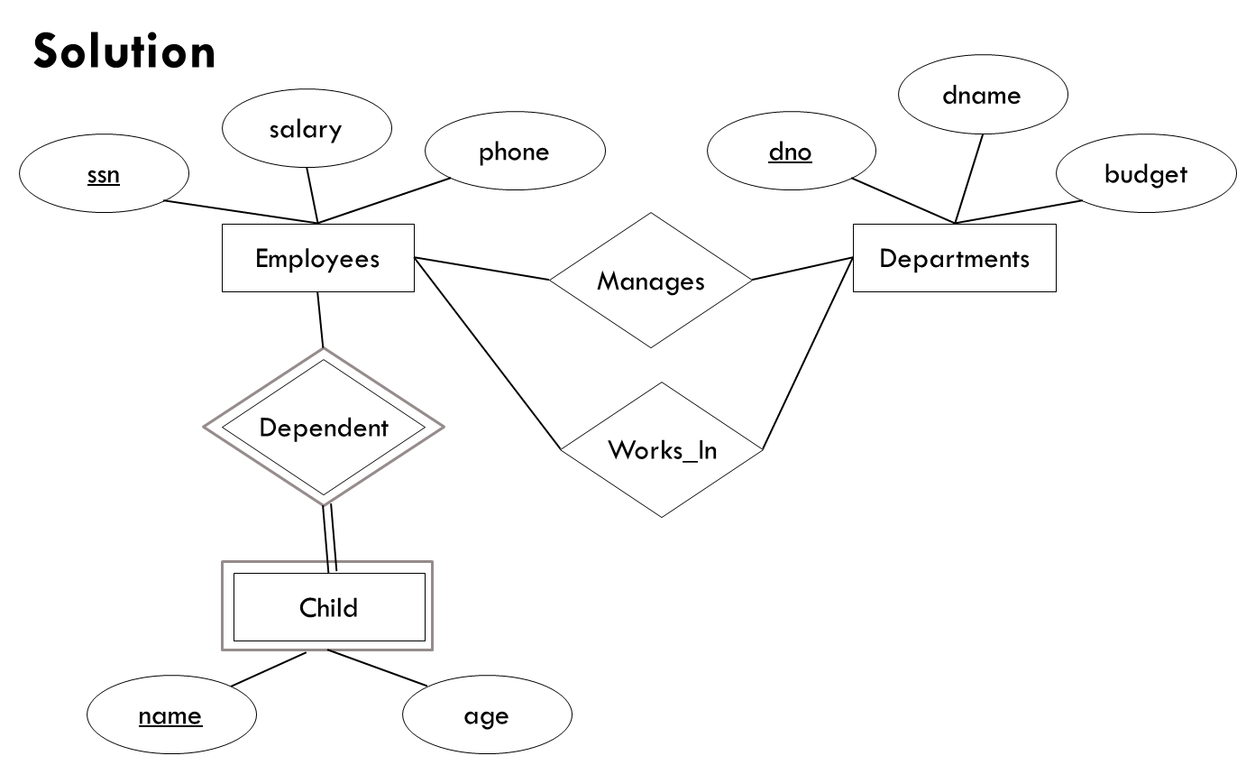
2.3 E-R Model

Slide 51
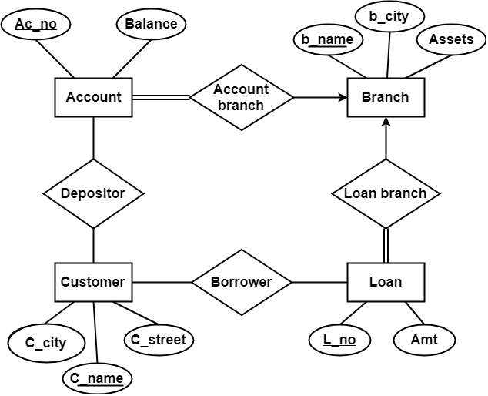
2.3 E-R Model
Example : E-R diagram of Banking Enterprises.

Slide 52
2.3 E-R Model
Assignment :
Practice ER Diagram Question – A Sample Solution
Suppose you are given the following requirements for a simple database for the National Cricket League (NCL):
the NCL has many teams,
each team has a name, a city, a coach, a captain, and a set of players,
each player belongs to only one team,
each player has a name, a position (such as left wing or goalie), a skill level, and a set of injury records,
a team captain is also a player,
a game is played between two teams (referred to as host_team and guest_team) and has a date (such as OCt 3rd, 2020) and a score (such as 4 to 2).
Construct a clean and concise ER diagram for the NCL database. List your assumptions and clearly indicate the cardinality mappings as well as any role indicators in your ER diagram.

Slide 53
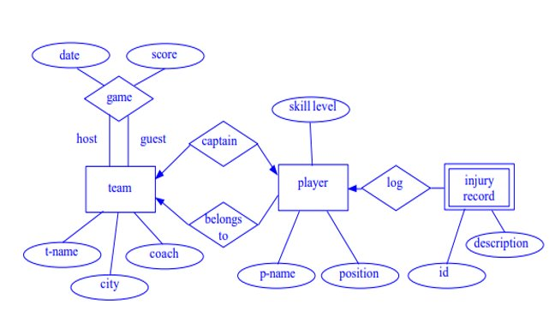
2.3 E-R Model
Assignment :
Practice ER Diagram Question – A Sample Solution

Slide 54
2.3 E-R Model
Extended feature of E-R Model:
As part of the Enhanced ER Model, along with other improvements, three new concepts were added to the existing ER Model, they were:
Generalization
Specialization
Aggregation
Let's understand what they are, and why were they added to the existing ER Model

Slide 55
2.3 E-R Model
Extended feature of E-R Model:
1. Generalization
Generalization is a bottom-up approach in which two lower level entities combine to form a higher level entity.
In generalization, the higher level entity can also combine with other lower level entities to make further higher level entity.
It's more like Superclass and Subclass system, but the only difference is the approach, which is bottom-up.
Hence, entities are combined to form a more generalized entity, in other words, sub-classes are combined to form a super-class.

Slide 56
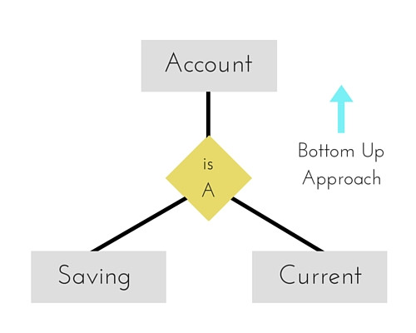
2.3 E-R Model
Extended feature of E-R Model:
1. Generalization
For example, Saving and Current account types entities can be generalized and an entity with name Account can be created, which covers both.

Slide 57
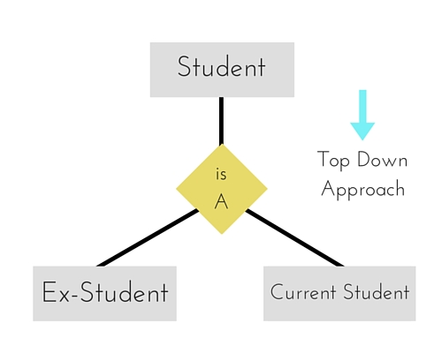
2.3 E-R Model
Extended feature of E-R Model:
2. Specialization
Specialization is opposite to Generalization.
It is a top-down approach in which one higher level entity can be broken down into two lower level entity.
In specialization, a higher level entity may not have any lower-level entity sets, it's possible.

Slide 58
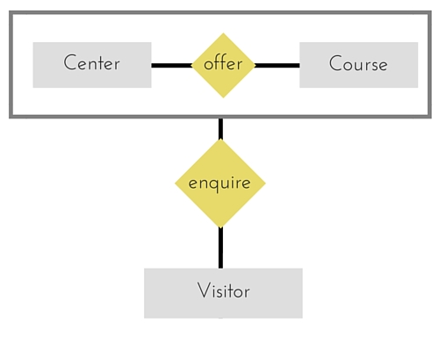
2.3 E-R Model
Extended feature of E-R Model:
3. Aggregation
Aggregation is a process when relation between two entities is treated as a single entity.
In the diagram above, the relationship between Center and Course together, is acting as an Entity, which is in relationship with another entity Visitor.

Slide 59
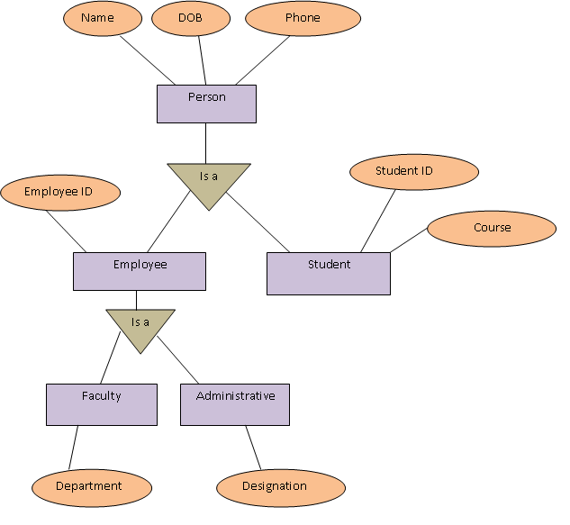
2.3 E-R Model
Extended feature of E-R Model: Specialization and Generalization

Slide 60
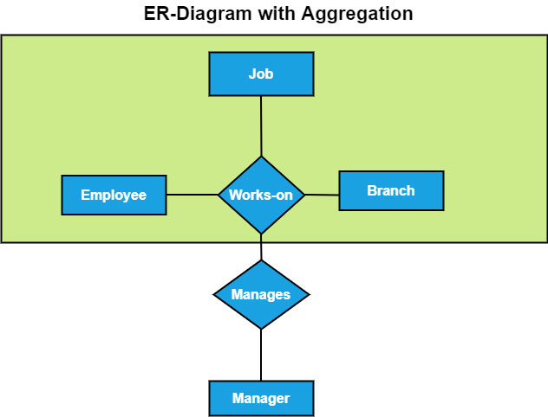
2.3 E-R Model
Extended feature of E-R Model: Aggregation

Slide 61
2.3 E-R Model
Assignment
Draw an ER diagram of library management system.

Slide 62
2.4 Relation with UML Class Diagram
UML: Unified Modeling Language
UML has many components to graphically model different aspects of an entire software system.
Example: Use case diagram, activity diagram, sequence diagram, Class diagram.
UML class diagram corresponds to E-R diagram, but several differences.

Slide 63
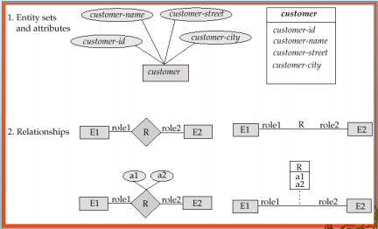
2.4 Relation with UML Class Diagram
UML Notation

Slide 64
2.4 Relation with UML Class Diagram
Contd.
Entity sets are shown as boxes, and attributes are shown within the box, rather than as separate ellipses in E-R diagrams.
Binary relationship sets are represented in UML by just drawing a line connecting the entity sets. The relationship set name is written adjacent to the line.
The role played by an entity set in a relationship set may also be specified by writing the role name on the line, adjacent to the entity set.
The relationship set name may alternatively be written in a box, along with attributes of the relationship set, and the box is connected, using a dotted line, to the line depicting the relationship set.
Non-binary relationships drawn using diamonds, just as in ER diagrams

Slide 65
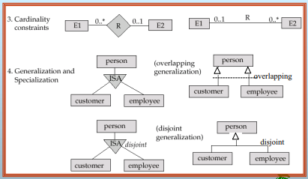
2.4 Relation with UML Class Diagram
Contd.
UML Notation

Slide 66
2.4 Relation with UML Class Diagram
Contd.
Cardinality constraints are specified in the form l..h , where l denotes the minimum and h the maximum number of relationships an entity can participate in.
Beware: the positioning of the constraints is exactly the reverse of the positioning of constraints in E-R diagrams.
The constraint 0..* on the E2 side and 0..1 on the E1 side means that each E2 entity can participate in at most one relationship, whereas each E1 entity can participate in many relationships; in other words, the relationship is many to one from E2 to E1.
Single values, such as 1 or * may be written on edges; The single value 1 on an edge is treated as equivalent to 1..1, while * is equivalent to 0..*.

Slide 67
2.5 Alternate Data Model
Hierarchical Model
This database model organizes data into a tree-like-structure, with a single root, to which all the other data is linked.
The hierarchy starts from the Root data, and expands like a tree, adding child nodes to the parent nodes.
In this model, a child node will only have a single parent node.
This model efficiently describes many real-world relationships like index of a book, recipes etc.
Data is organized into tree-like structure with one one-to-many relationship between two different types of data.

Slide 68
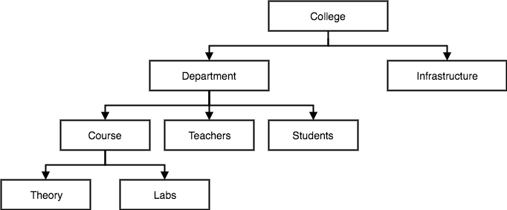
2.5 Alternate Data Model
Contd.
Hierarchical Model

Slide 69
2.5 Alternate Data Model
Network Model
This is an extension of the Hierarchical model.
Data is organized more like a graph, and are allowed to have more than one parent node.
Data is more related as more relationships are established in this database model.
Also, as the data is more related, hence accessing the data is also easier and fast.
This database model was used to map many-to-many data relationships.
This was the most widely used database model, before Relational Model was introduced.

Slide 70
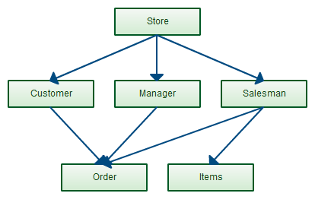
2.5 Alternate Data Model
Contd.
Network Model

Slide 71
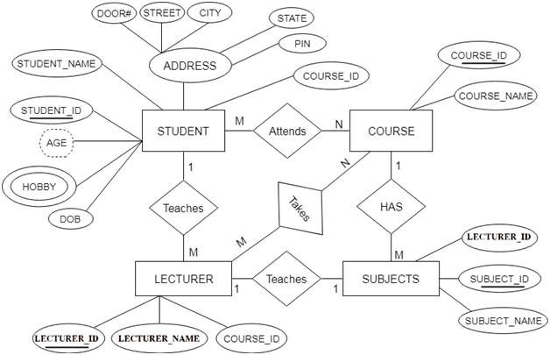
Reducing E-R diagram to Tables

Slide 72
Reducing E-R diagram to Tables
Contd.
Some points to remember:
Entity type becomes a table.
In the given ER diagram, LECTURE, STUDENT, SUBJECT and COURSE forms individual tables.
All single-valued attribute becomes a column for the table.
In the STUDENT entity, STUDENT_NAME and STUDENT_ID form the column of STUDENT table. Similarly, COURSE_NAME and COURSE_ID form the column of COURSE table and so on.
A key attribute of the entity type represented by the primary key.
In the given ER diagram, COURSE_ID, STUDENT_ID, SUBJECT_ID, and LECTURE_ID are the key attribute of the entity.

Slide 73
Reducing E-R diagram to Tables
Contd.
Some points to remember:
The multivalued attribute is represented by a separate table.
In the student table, a hobby is a multivalued attribute. So it is not possible to represent multiple values in a single column of STUDENT table. Hence we create a table STUD_HOBBY with column name STUDENT_ID and HOBBY. Using both the column, we create a composite key.
Composite attribute represented by components.
In the given ER diagram, student address is a composite attribute. It contains CITY, PIN, DOOR#, STREET, and STATE. In the STUDENT table, these attributes can merge as an individual column.
Derived attributes are not considered in the table.
In the STUDENT table, Age is the derived attribute. It can be calculated at any point of time by calculating the difference between current date and Date of Birth.

Slide 74
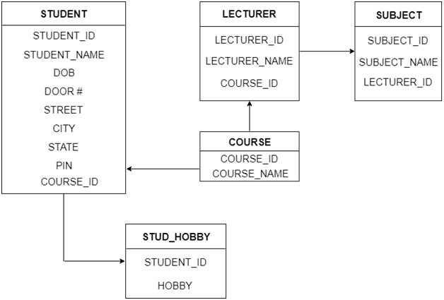
Reducing E-R diagram to Tables
Contd.
Table structure for the given ER diagram is as below:

Slide 75
Reducing E-R diagram to Tables
If you want to know more about how to reduce E-R diagram to tables, just go to the given links.
http://www.exploredatabase.com/2017/07/reduce-er-diagram-to-relation-table-solved-exercise.html
http://www.exploredatabase.com/2016/04/convert-entity-relationship-diagram-to-relation-schemas-exercises.html

Slide 76
This is the end of the lecture!
I hope you enjoyed it.
Thank You

